Slide 1

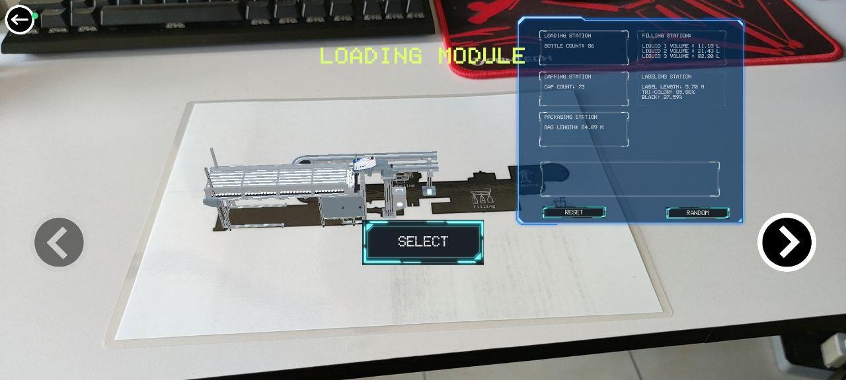
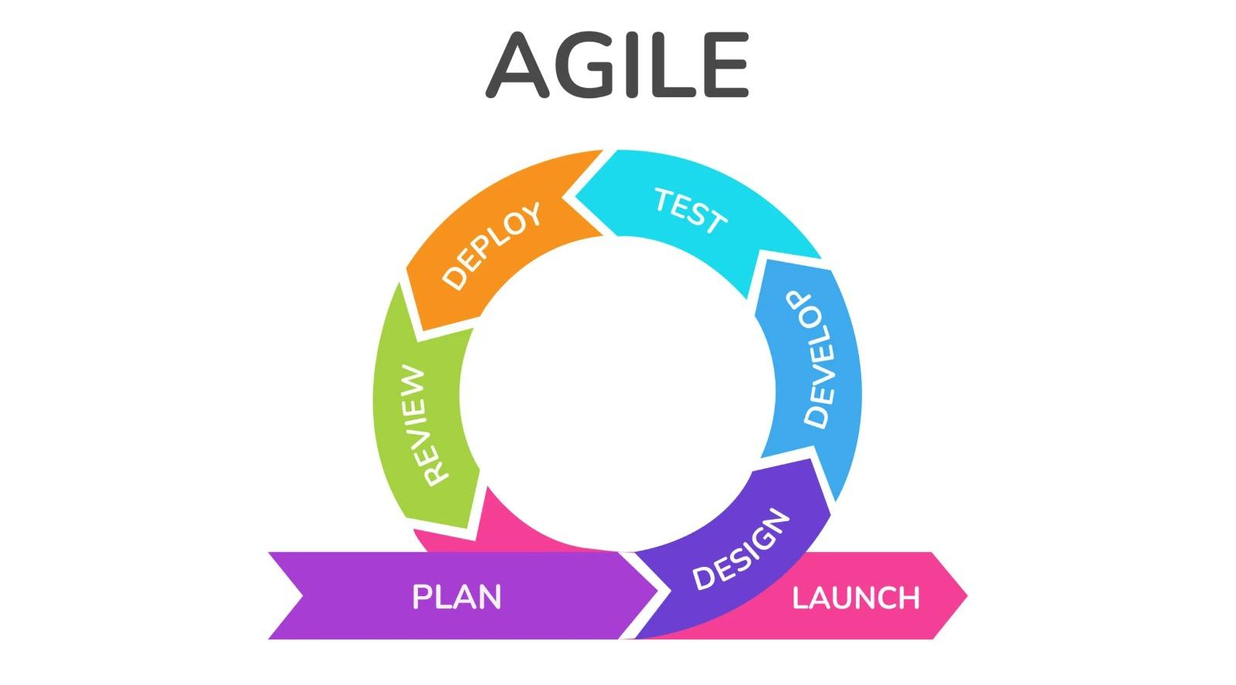






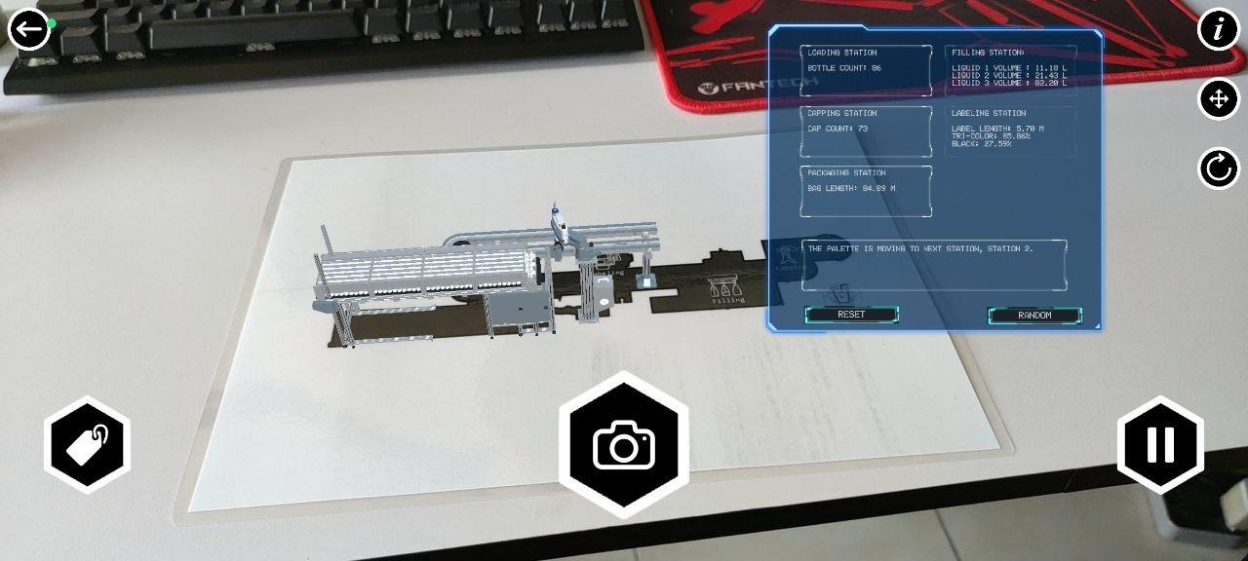
JuiceLineAR: An Education
and Infotainment AR Tool
Chong Zhi Hong, Tan Yan Pin
Bachelor of Software Engineering (RSW)
Supervisor: Dr Tew Yiqi
JuiceLineAR revolutionizes bottled water manufacturing education through interactive augmented reality modules. Despite success, a challenge lies in direct data exchange due to time constraints. The project, developed with Unity and Blender, serves as a foundation for future innovations in augmented reality education.
Abstract
Address challenge in Augmented Reality (AR)
Function as an educational resource
Provide a visual representation of the manufacturing line
To provide an example of usage of augmented reality technology
Low user awareness.
Lack of proven business models beyond gaming.
Absence of standardized design and development.
Existing AR applications seen as one-time gimmicks, resulting in low retention rates.
Limited expertise in the field hinders the creation of accessible and useful AR experiences.
Objectives
Problem Statement
JuiceLineAR will display the model and the user interface when the marker is detected, if the marker is out of range, an error message will prompt the user to scan the marker to continue operation.
Figure 1: Model selection
Figure 1 show the model selection where user can select which station of the manufacturing line to view animation.we can see the model of the manufacturing line on top of the silhouette of the marker, along with the tagging panel that show details and informations of the manufacturing line.
Figure 2: Animation and Tagging
from Figure 2 after selected model, we can play animation of the selected model. There is also some function such as turn on or off tagging, snap picture, information, enable or disable movable object, and reset position. In tagging there is also 2 function, reset information and randomized data.
Construction and Testing
Design and Methodology
In our project, Agile development emerged as the preferred methodology, given the dynamic nature of our evolving requirements and the relatively short 5-month project lifespan. This approach allows us the flexibility to adapt to changing needs throughout the development process.
Figure 1: Agile Methodology Figure 3: Development Tools
Figure 2: Development Flow
The figure above shown the development methodology and development tools that are used in our project, and the flow of our project development
1
Understanding Basic Concepts of AR and Unity
2
Building User Interfaces and Functionality
3
Reanimating The Model
4
Integrating Modules and UI
5
Compile and Build Android Package (APK)
Formidable educational tool
Engaging user interface
Make use of manufacturing process model with animation
Implemented augmented reality properly and usable
Augmented reality proof of concept
Contribution
In summary, JuiceLineAr successfully integrates augmented reality into infotainment tools, offering seamless guidance and information. The application excels in visualizing the manufacturing line model, presenting animated processes, and enriching learning with valuable information. It surpasses expectations, delivering an enjoyable and transformative educational experience through innovative augmented reality use.
Conclusion

